Slide 1
Lecture 4
Key Points Topic 1
Notes:
Let us wrap up some key points of this first topic about numerical algorithms and numerical errors

Slide 2
Using numerical algorithms
Algorithm
x_{i}
x_{i+1}
Error < TOL
Error > TOL
Notes:
Numerical methods produce iteratively a succession of approximations xi of an exact solution r for a given mathematical problem.
The algorithm itself doesn’t tell anything about how good or how poor this approximation is.
To assess the quality of this approximation, meaning estimating the error between the approximation xi and the true solution r, requires additional analysis.
One has to iterate the algorithm up to the moment one can state with enough confidence that the estimated error is below a targeted precision.

Slide 3
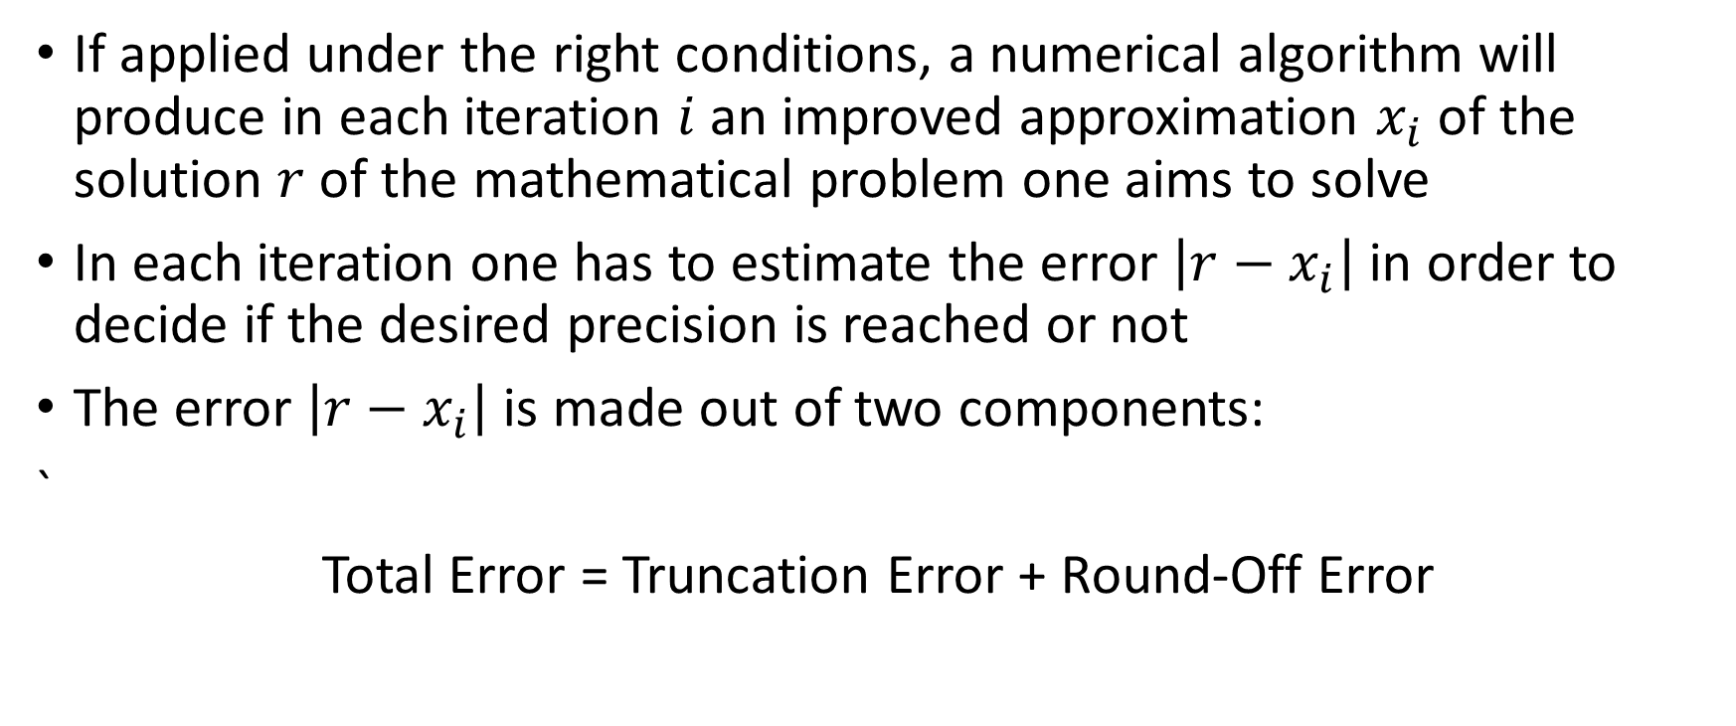
Numerical algorithms
If applied under the right conditions, a numerical algorithm will produce in each iteration $i$ an improved approximation $x_{i}$ of the solution $r$ of the mathematical problem one aims to solve
In each iteration one has to estimate the error $\left|r−x_{i}\right|$ in order to decide if the desired precision is reached or not
The error $\left|r−x_{i}\right|$ is made out of two components:
`
Total Error = Truncation Error + Round-Off Error
Notes:
If applied under the right conditions, a numerical algorithm will produce in each iteration $i$ an improved approximation $x_{i}$ of the solution $r$ of the mathematical problem one aims to solve
In each iteration one has to estimate the error $\left|r−x_{i}\right|$ in order to decide if the desired precision is reached or not
We have as well learned that the error $\left|r−x_{i}\right|$ is made out of two components: truncation and round-off errors.

Slide 4
Typical behavior of total numerical error
Log(Total Error)
Truncation error
Round-off error
Number of iterations
Notes:
In the course of this semester we are going to learn that the total error can not be made as small as desired.
If one increases the number of iterations of the algorithm, the error will at first indeed decrease, but eventually it will grow.
This U-shaped behavior comes from the competition between truncation and round-off errors.
Typically, as the number of iterations increase, the truncation error will decrease. If only truncation errors would be present, the error would eventually vanish and become zero.
The problem is that with increasing number of iterations, which typically means the calculations become more sensitive to round-off errors, the round-off error will grow and eventually become indefinitely large.
Operating numerical algorithms is always a trade-off and there is an optimal number of iterations that one should not cross.

